Slide 1
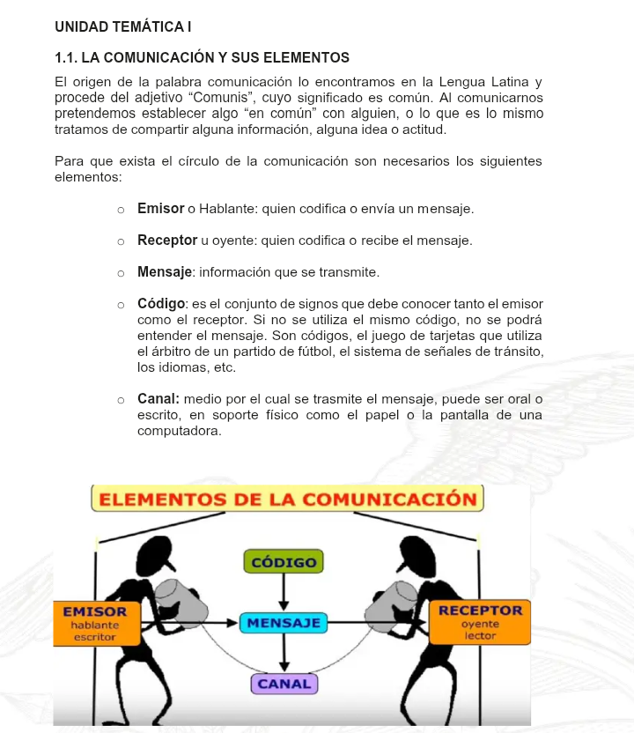

Slide 2
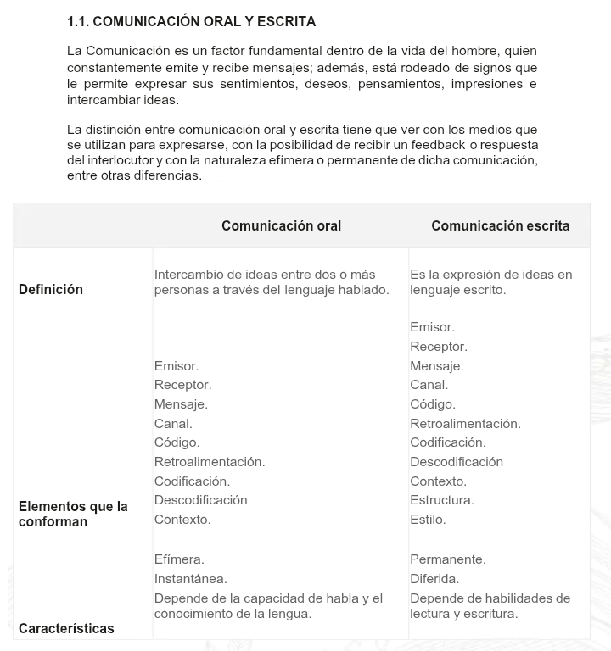

Slide 3


Slide 4
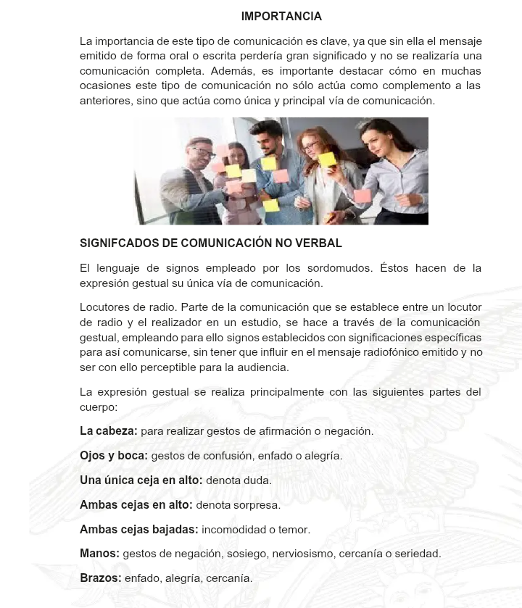

Slide 5
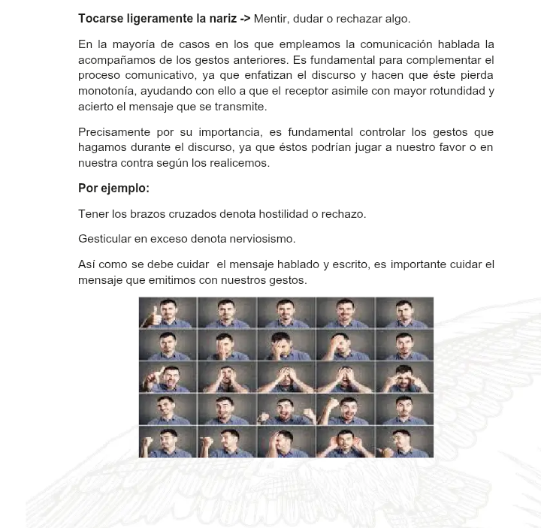

Slide 6
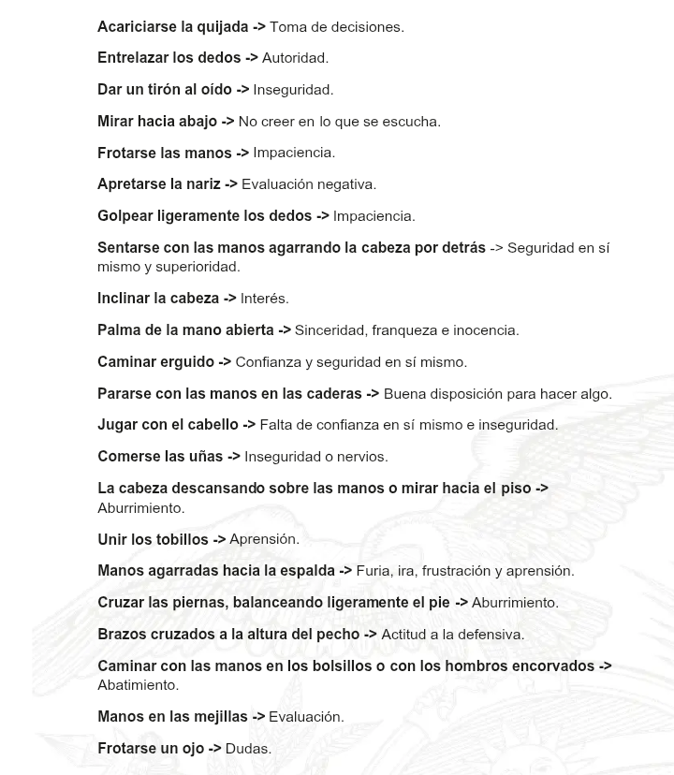

Slide 7
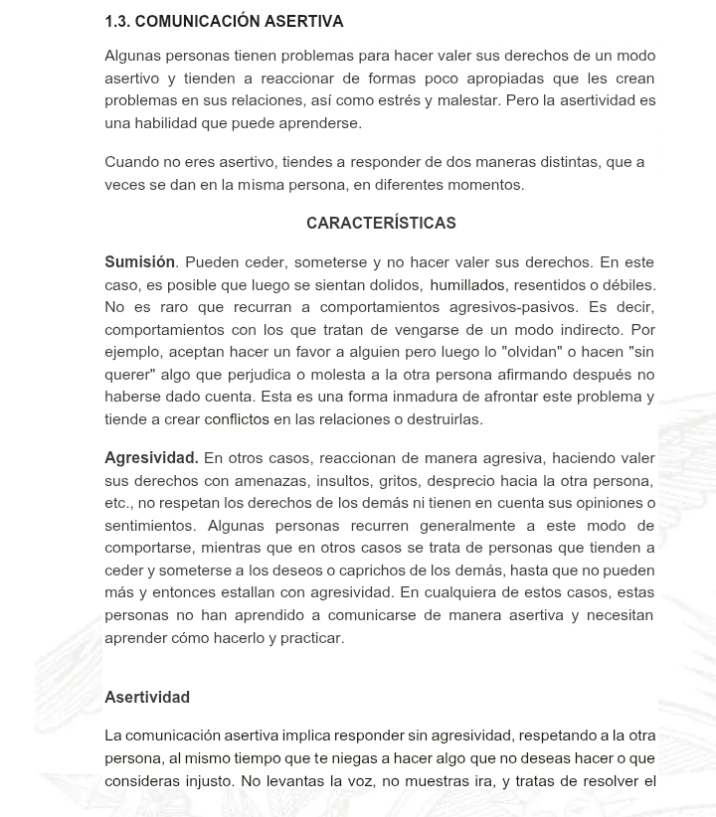

Slide 8
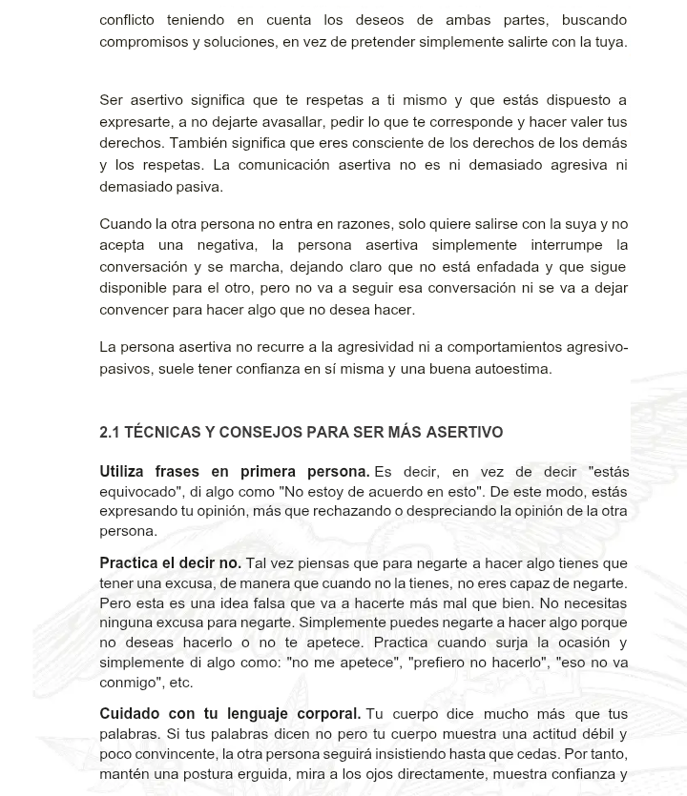

Slide 9


Slide 10
Link de actividad fin de módulo
Link: https://docs.google.com/forms/d/e/1FAIpQLScP0MUXv1sySV3T5KMACI3WVVKiIEZbMUe5A0jiQStXg8092g/viewform?usp=header

